Slide 1

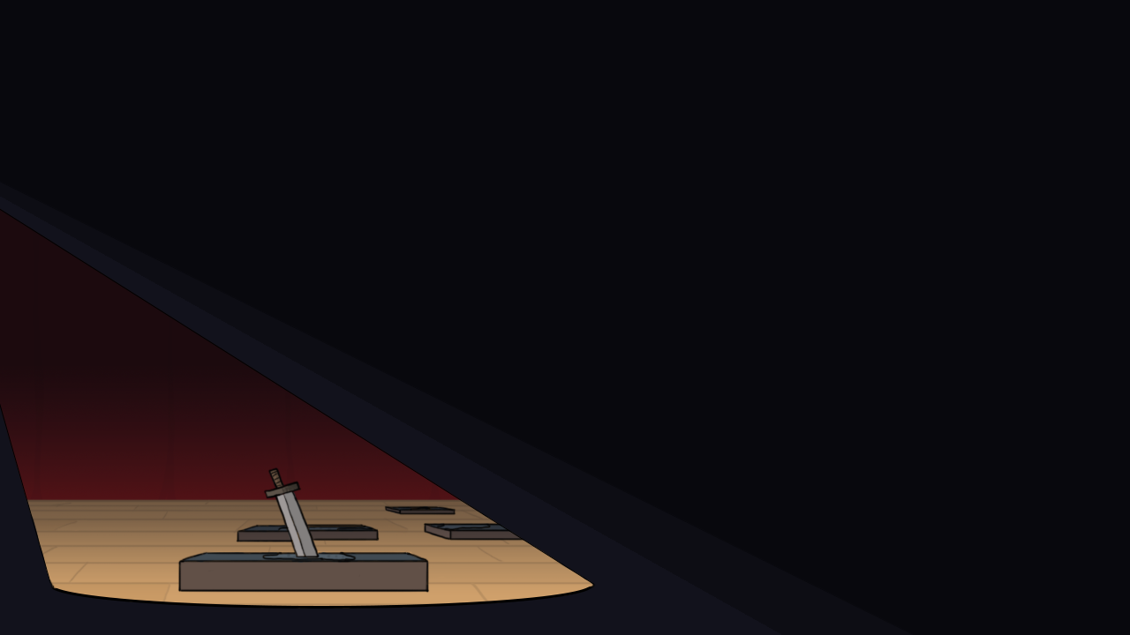
Nav Bhatti, Alex Kabak,
Chris Klassen, Rene Ye
Notes:
Chris

Slide 2
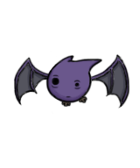
Introduction
Staged!
Action-strategy role-playing game
You play as a party of 3 trapped in a dungeon
Explore arenas, avoiding traps
Fight enemies in turn-based, minigame-driven combat
Notes:
Chris

Slide 3
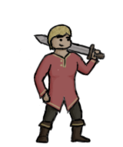
Inspirations
Japanese Role-Playing Games
Turn-based combat
Paper Mario
Minigame attacks
Theatre/Board Games
General aesthetic
Notes:
Rene

Slide 4

Target Audience
Target player profile:
Ages 12-30
Male or female
Some experience with the JRPG genre
No requirement for large amounts of free time
Games last roughly 30 minutes
Saving and loading allows for pick up and play
Notes:
Rene

Slide 5
Demo
Notes:
Demo:
Chris talks about story, dialogue (while dialogue plays out behind him)
Alex talks about the arena structure, design, generation, enemy movement, traps
Rene talks about the battle structure, design, aesthetic, strategy
Nav talks about gambits as we play through the game
Alex talks about scoring and high scores at level end
-- Jump forward to Stage 5 --
Chris talks about content, new areas and enemies, mystery box
Nav talks about gambit difficulty
-- Jump forward to the final boss –
Chris talks about the final boss and opens the floor to questions during the boss fight
Chris talks about the end-game if we get that far
All members take questions based on the question asked

